Slide 1


Slide 2
Financial: how to get the most of my ISLA?
Two sources of income for Insula:
Insula Premium subscriptions & Investment fees.
With ISLA you can:
-1-Hold ISLA and get paid dividends
Or to sell/invest ISLA on :
-2-Other cryptos
-3-ISLA Liquidity pool
-4-Insula Crypto Funds
-5-Insula Premium
Consulting
$
Investment
$
Learn more about the possible options here:
https://docs.google.com/document/d/198j-8ErcyCMZkiRLi8JfdpNSPAA_1iEKq8JhCnAiW6o/edit

Slide 3

1-Hold ISLA and get paid dividends (Long run horizon):
GISLA entitles you to a portion of our managed funds performance fees. From next month onwards, we will collect the funds fees in $ETH and then buy ISLA with this and distribute it to the relevant token holders. The more #ISLA you hold, the larger the amount you will receive.
1.a Buy ISLA on Uniswap: high trading fees.
https://uniswap.info/token/0x697ef32b4a3f5a4c39de1cb7563f24ca7bfc5947
1.b Buy ISLA on P2PB2B: low trading fees.
https://p2pb2b.io/trade/ISLA_BTC
https://p2pb2b.io/trade/ISLA_ETH
https://p2pb2b.io/trade/ISLA_USDT

Slide 4
2-ISLA/other crypto (Short run horizon):
2.a Sell ISLA high, and buy low against 100+ other cryptocurrencies (including ETH/USDT on Uniswap): high trading fees.
https://uniswap.info/token/0x697ef32b4a3f5a4c39de1cb7563f24ca7bfc5947
2.b Sell ISLA high, and buy low against 100+ other cryptocurrencies (including BTC) (on P2PB2B): low trading fees.
https://p2pb2b.io/trade/ISLA_BTC
https://p2pb2b.io/trade/ISLA_ETH
https://p2pb2b.io/trade/ISLA_USDT

Slide 5
3-Liquidity pool (Middle run horizon):
3.1. Why use the ISLA liquidity pool?
Provide liquidity
The ISLA token currently has 520+ unique holders. In order to provide liquidity for new investors to enter the market, Inusla has elected to use liquidity pools as a simple means to provide liquidity in this new market. As an investor you can stake ISLA and ETH to provide this liquidity and generate returns.
Generate returns
An investor can generate returns using the liquidity pool by staking their tokens. The returns are generated any time an ISLA trade is processed. On every trade there is a transaction fee of 0.3 - 0.6% which is distributed to the liquidity pool evenly. If you as an investor provide 20% of the total liquidity pool, then on every transaction, you will receive 20% if the 0.3% transaction fee. Providing liquidity allows for higher volumes which in turn provides higher transaction fees.
2.2. How to invest in the ISLA liquidity pool?
In order to invest in the ISLA liquidity pool, an investor will require a Web3 wallet supported by Uniswap. You will also need a positive and equal amount of ETH and ISLA in the wallet.
Important: If an investor wants to invest 10 ETH of total liquidity into the pool, they may want to buy 5 ETH worth of ISLA and place that with the corresponding 5 ETH into the pool. However buying 5 ETH worth of ISLA may increase the price of ISLA/ETH. As a result the investor will require to put in more ETH to match the all the ISLA tokens that were bought, or keep some ISLA in their wallet

Slide 6
4-ISLA to ETH to Insula Fund: (Long Run horizon):
4. Sell ISLA against ETH and invest it into Insula Decentralized Funds.

Slide 7
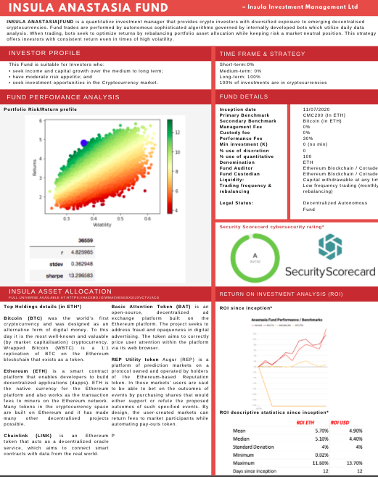
Fund fact sheet:

Slide 8
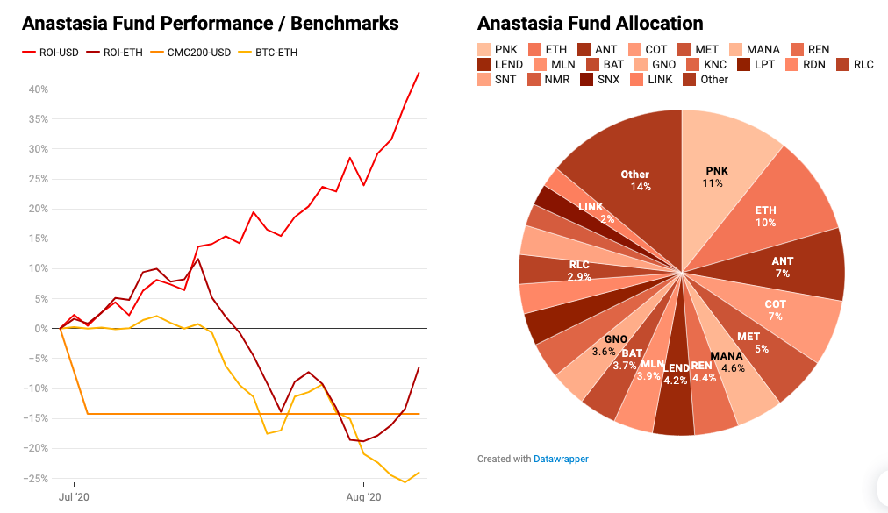
The Fund: Anastasia
Understanding Fund Returns:
The Insula Funds present returns in USD and ETH. The inherit value of both these returns is the same, however the differences in the curves comes from the fluctuations in the ETH/USD price.
Say for example BTC was worth 10k when we bought it and the price of ETH/USD was 100. We buy 1 BTC in the fund, then the fund value in USD is 10k. But the fund value can also be represented in ETH and be 100 ETH. Now 1 week later BTC is worth 11k and ETH/USD is 200. Then our fund value in USD is 11k meaning we have made 10% returns. But the fund value in ETH is 55 meaning we lost 45%.
As we are a crypto focused company our base currency is ETH, so we want to generate returns in ETH, and we take our performance fee in ETH. Take the previous example, we would not take any performance fee on the investment because we have negative returns in ETH.
We believe that crypto enthusiasts are also interested in this metric, and this is where we take our performance, so that is why its on the graph. However in todays society we cannot use ETH to pay for much, so investors are also curious to see their returns that can be used outside crypto so this is why we present the returns in USD. Understanding benchmarks In order to show investors that we are outperforming the market and that they should invest with us we have to show them what the market is doing (an index) the CMC200 index is our benchmark that we are trying to beat.
The returns for this index are in USD so we have to compare apples to apples and compare or fund ROI in USD to the CMC200 benchmark. We also felt that BTC was a good benchmark as it is the leader in the space and provides a benchmark for our ETH ROI.

Slide 9
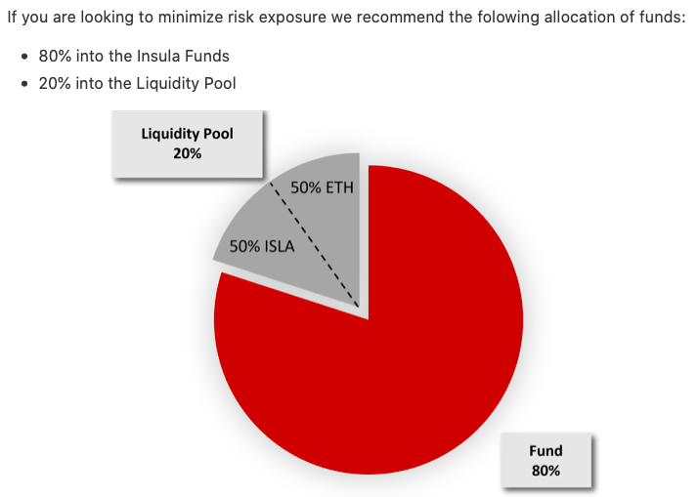
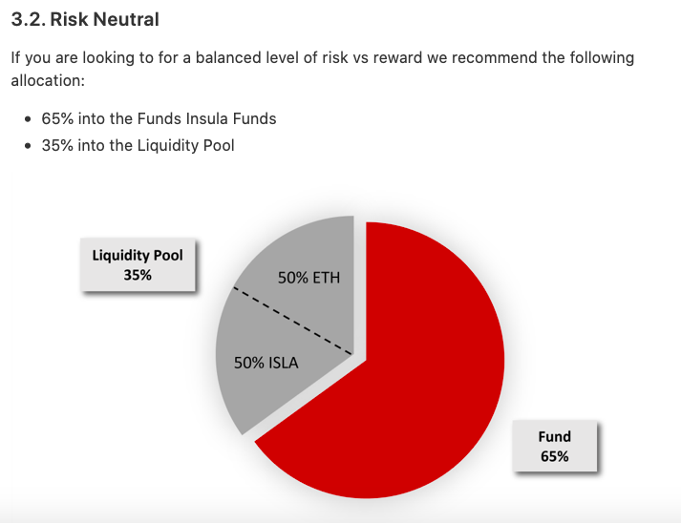
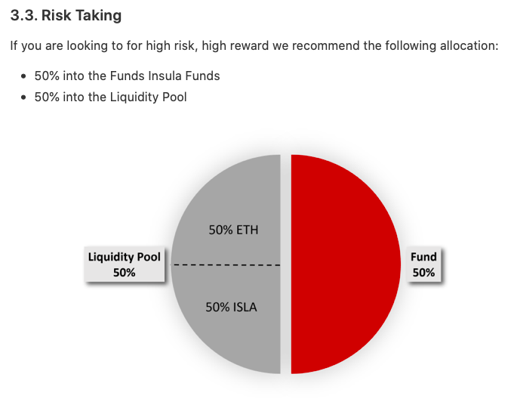
Investment template: How to allocate ETH between the pool & the funds?
https://hackmd.io/@VV473-xrSHmvw8JpAV-8bQ/SJDhXKS58

Slide 10
5-Premium
Monthly: 49 ISLA/month
Yearly: 499 ISLA/month
Taster session 15min
Duration: on demand, 15 mins video calls.
Format: Zoom video-call
Availability: 5/7 weekdays, 1pm-8.30 pm ECT (Paris Timezone).

Slide 11
​Insula Premium includes:​
Dedicated account manager for paid costumers.
Technical support around all of our investment products (Insula Funds, ISLA liquidity pool, ISLA token & how to use Metamask Wallet).
Updates on latest trends in the decentralised finance industry.
On-demand analysis of specific crypto-assets included in Insula Fund.
On-demand training: liquidity challenges, tax ramifications, appreciation timelines, the challenge of forecasting and measuring appreciation, the psychological component of collecting cryptocurrencies and the role of emotion in collectible investing.

